Slide 1

Global Weather Application Using React
Real-Time Weather Visualization with Google Maps &
Open Weather API
​

Slide 2
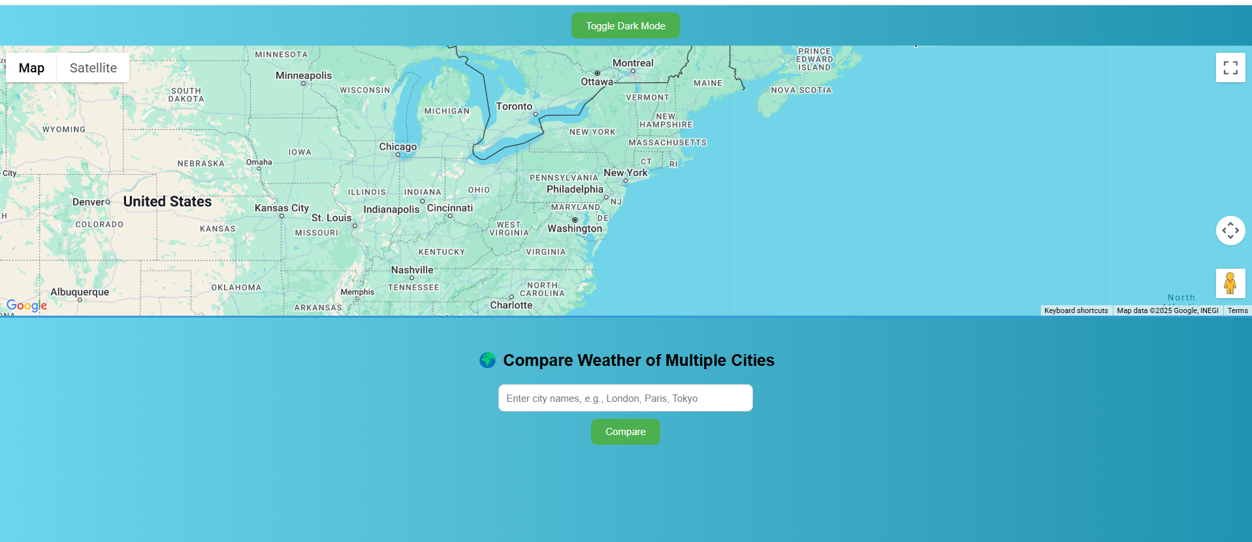
Project Overview
This project is a weather app that gives users up-to-date weather information and shows weekly temperature trends through an interactive and visually engaging interface.
Built with:
React.js (Frontend)
Open Weather API (Data source)
Google Maps API (User interaction)

Slide 3

Why This App? (Purpose & Usefulness)
This weather forecast app helps users quickly access real-time weather data and weekly temperature trends with a simple and engaging interface. It's designed for easy navigation and interaction, making it suitable for various use cases.
Goals:
Quick access to weather – Click anywhere on the map to see the current weather.
Simple and fun interface – Uses maps, graphs, and icons for easy data visualization.
Multiple use cases:
Travelers can plan trips better
Students and researchers can analyze climate data
Anyone can check if it’s a good day for outdoor activities

Slide 4
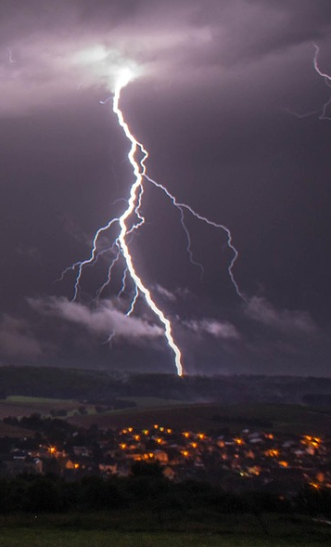
Features Overview
Interactive Map Click to View Weather Users can click anywhere on the map to instantly see the current weather for that location.
Real-Time Weather & Weekly Forecast Provides up-to-date weather data and a 7-day forecast to help users plan ahead.
Temperature Trends using Charts Visualizes temperature changes over the week with easy-to-understand graphs, helping users track weather patterns.
Compare Multiple Cities Allows users to compare the weather conditions of different cities side-by-side.
Toggle Dark Mode Users can switch to dark mode for a more comfortable viewing experience, especially at night.
Dynamic Background Based on Weather The app’s background changes according to the current weather, offering a visually immersive experience.

Slide 5

Tech Stack
Frontend: React js
Used to build the user interface, providing a responsive and dynamic experience.
APIs:
Open Weather API for real-time weather and forecasts.
Google Maps API to enable map-based location interaction.
Charting: Chart.js (via react-chartjs-2)
Used to visualize temperature trends in an easy-to-read chart.
HTTP Client: Axios
Handles API requests to fetch weather data.
Styling: CSS
Custom styles with weather themes and dark mode support.

Slide 6
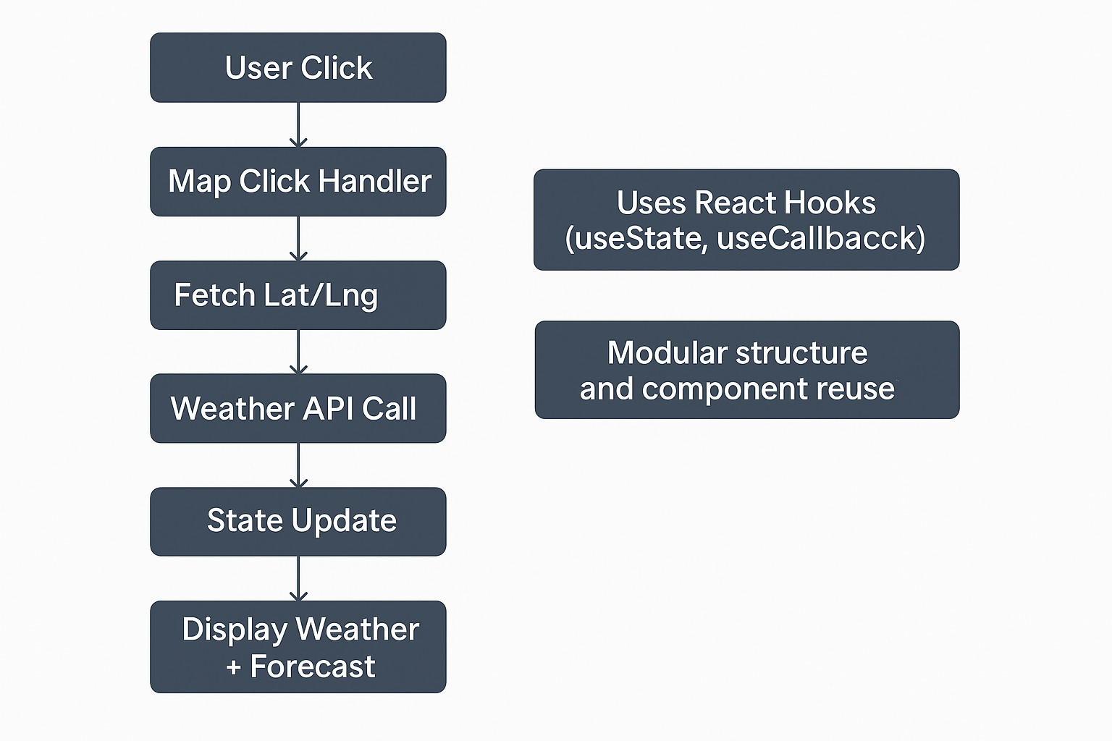

Application Architecture

Slide 7

API’S Used
OpenWeather API Used to get real-time and forecasted weather data for any location in the world.
Current Weather Endpoint https://api.openweathermap.org/data/2.5/weather
→ Returns live weather data like temperature, humidity, wind speed, etc.
5-Day Forecast Endpoint https://api.openweathermap.org/data/2.5/forecast
→ Provides temperature predictions for the next 5 days in 3-hour intervals.
Google Maps JavaScript API
Displays an interactive map on the screen.
Captures user clicks to get the latitude and longitude of the selected location.
These coordinates are sent to the OpenWeather API to fetch weather info.

Slide 8
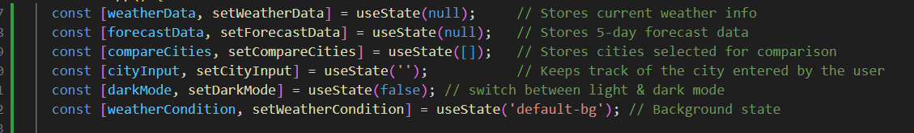
State Management
React’s useState is used to manage all important data in the app.
Each state variable controls a specific part of the user interface.
Each piece of data is managed separately Makes the app easy to update and maintain
When something changes, the screen updates automatically

Slide 9
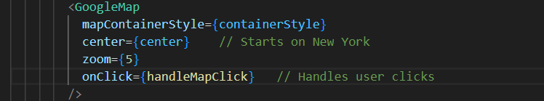
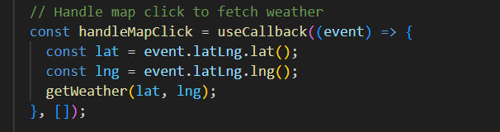
Google Maps Integration
We use the Google Maps JavaScript API to show a map and let users interact with it.
The map shows up on the screen with a default center (New York).
When the user clicks anywhere on the map, the app gets that location’s latitude and longitude.
It then fetches weather info for that location using the getWeather(lat, lng) function.
This makes it easy to explore weather conditions by just clicking around the world.

Slide 10
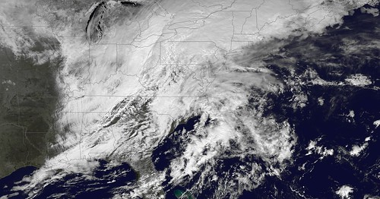

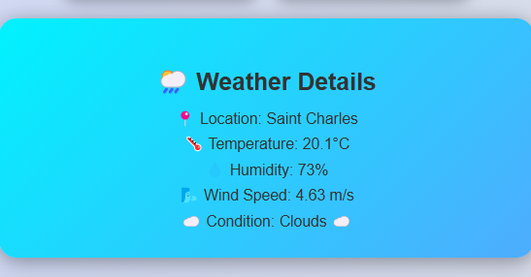
Fetching Weather
This function gets weather data when a user clicks on the map or searches for a city.

Slide 11
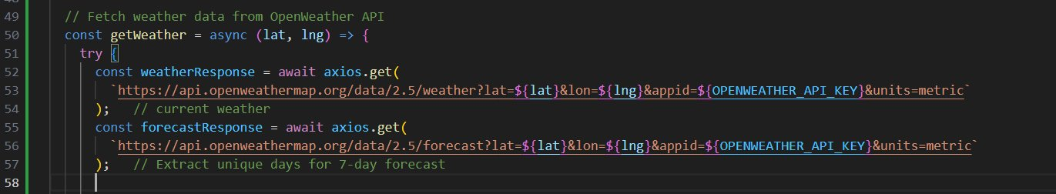
The function runs two API calls:
One to get the current weather (temperature, humidity, etc.)
One to get the 5-day forecast (hourly updates for the next few days)
This helps the app stay dynamic and show accurate information with every click!

Slide 12
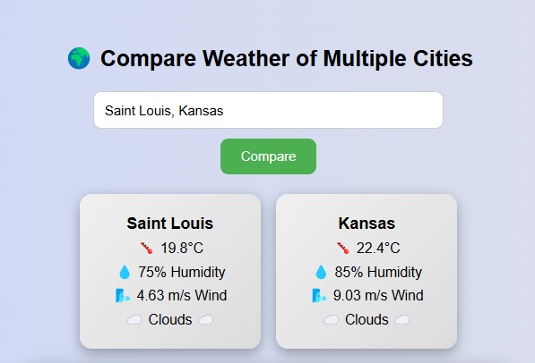
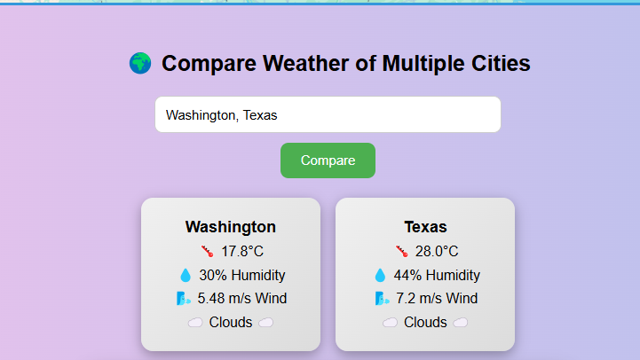
Weather Comparison Feature
This feature lets users compare weather in multiple cities at once.

Slide 13
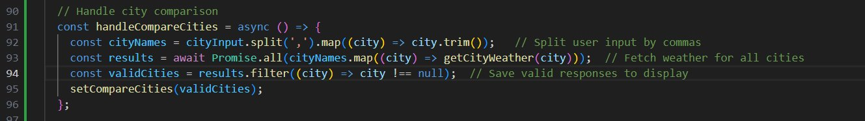
How it works:
The user types in multiple city names, separated by commas.(Ex: "New York, London, Tokyo")
The app uses the getCityWeather function to fetch weather data for each city.
The results are filtered to remove any errors and then shown in the UI.
What users see:
A card for each city showing:Temp, Humidity, Wind speed,Weather condition (like sunny, cloudy, etc.)
This feature is helpful for:
Planning trips across different locations
Comparing climates in different regions

Slide 14
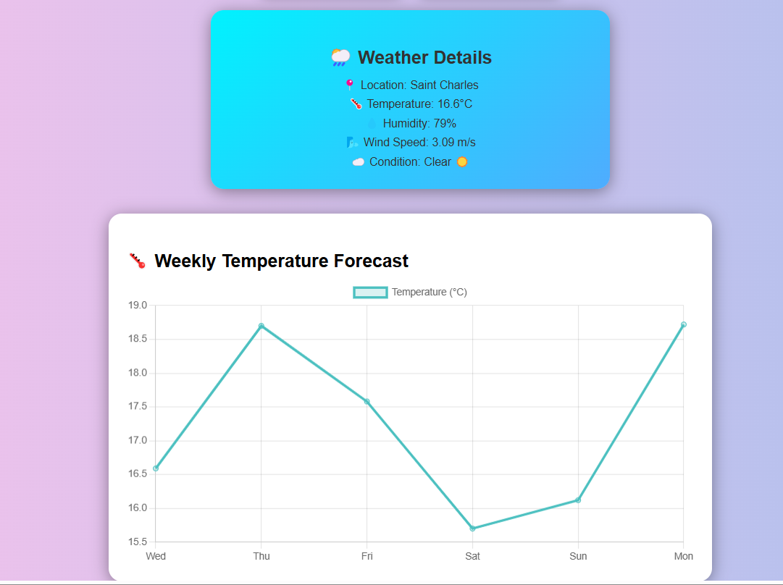
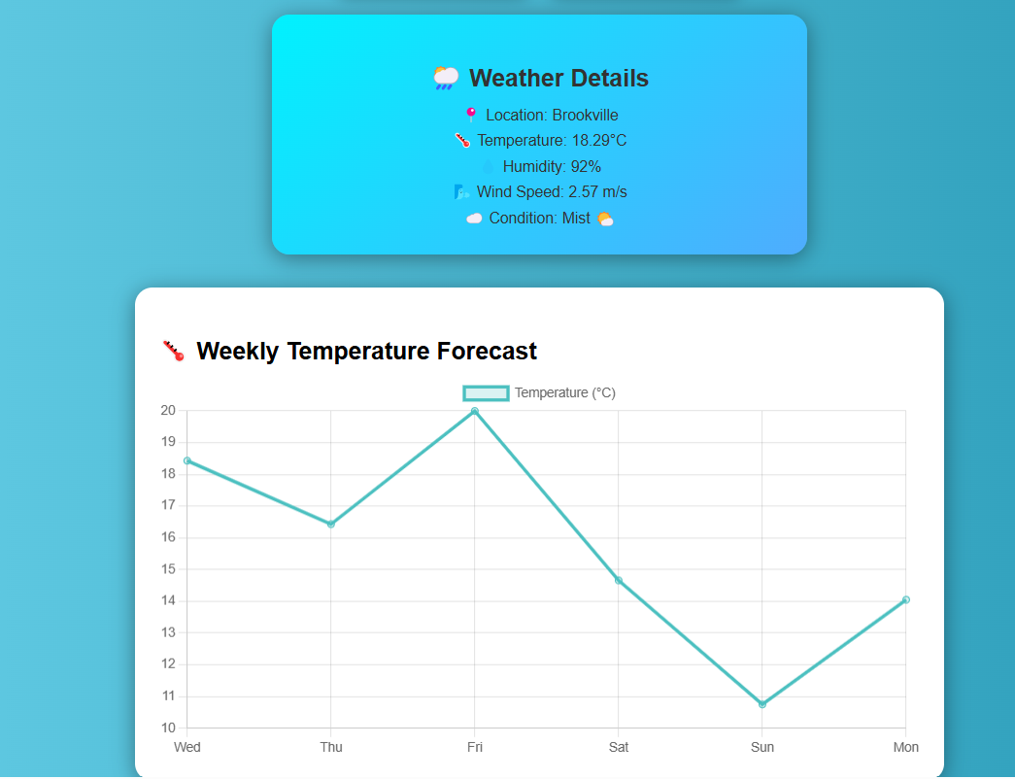
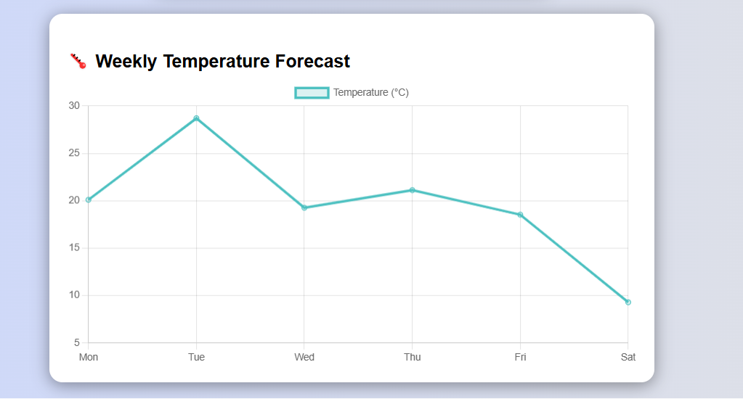
Chart.js Temperature Graph

Slide 15
What it does:
Uses Chart.js to show a line graph of temperature trends
Forecast data is processed to extract 6 unique days
How it works:
Each point on the graph represents the average temperature for that day
The line helps visualize temperature changes throughout the week
Why it's useful:
Offers a clear overview of how the weather will vary
Helps users plan their week with easy-to-read visuals
Makes the app more interactive and informative

Slide 16
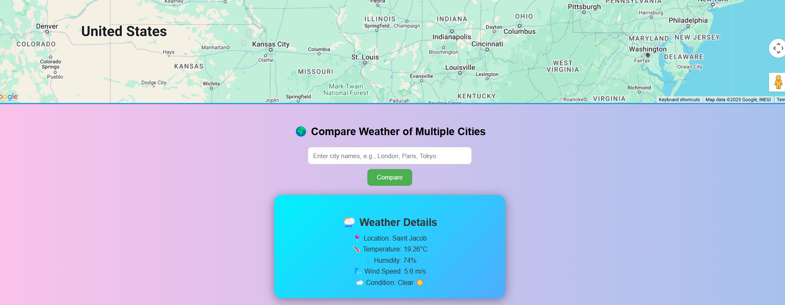
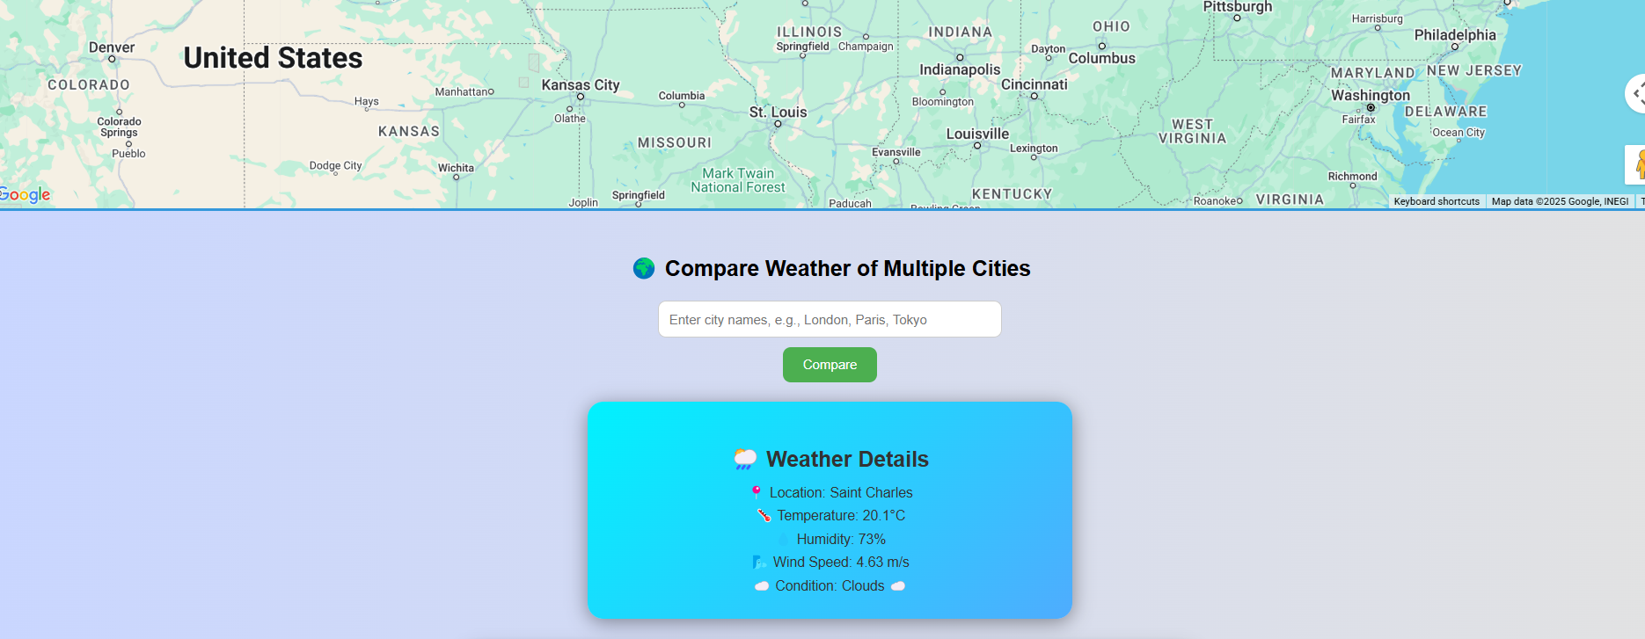
Dynamic Backgrounds

Slide 17
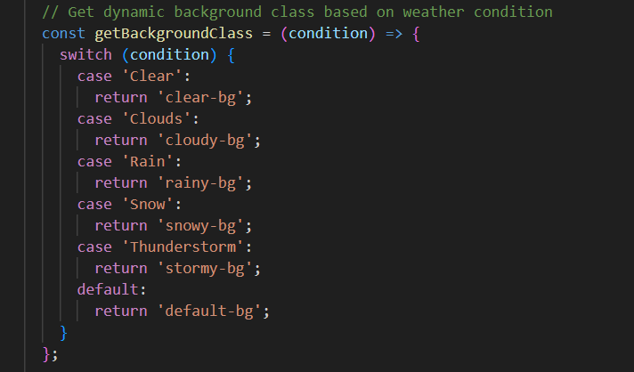
What it does:
Checks the current weather condition (like Clear, Clouds, Rain, etc.)
Changes the background class of the app accordingly
Why it's useful:
Makes the app feel more responsive and lively
Gives users a visual hint of the current weather without needing to read it
Example: If it's cloudy, a cloudy-themed background appears

Slide 18

Dark Mode Toggle
When the user clicks the button, it switches the app between light mode and dark mode.
How it works:
A CSS class called dark-mode is added or removed from the main container.
The colors, backgrounds, and text styles automatically update based on the selected mode.
Why it's useful:
Helps reduce eye strain, especially in low-light environments.
Makes the app look modern and user-friendly.
Users can choose the mode they prefer.

Slide 19

CSS Styling Overview
Our app uses a custom App.css file to control how everything looks. It includes styles that change based on weather, theme, and layout.
Key Styling Features:
1) Weather-Based Backgrounds
2)Dark Mode Styles
3)Layout Styling

Slide 20
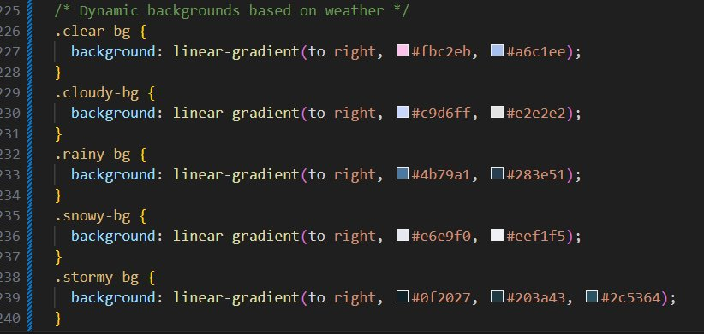
1) Weather-Based Backgrounds:
Different weather conditions trigger different background colors or images to make the app feel more realistic.
Example:

Slide 21
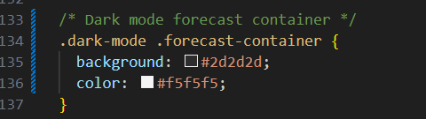
2) Dark Mode Styles:
A .dark-mode class changes the app's color theme for night or low-light use.
Example:

Slide 22
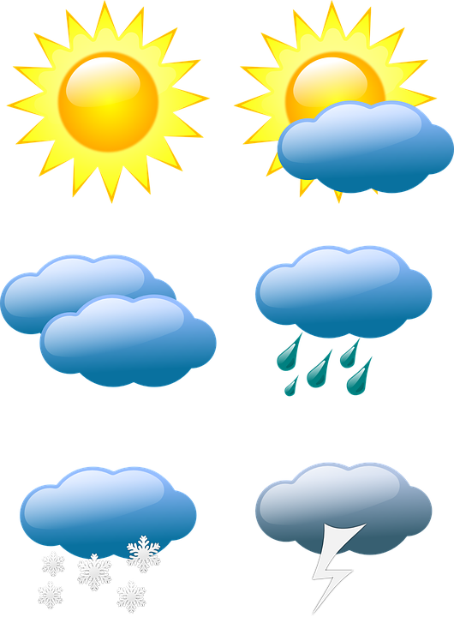
3) Layout Styling:
The layout styling in App.css makes sure that all parts of the app — like the map, weather cards, and graphs — are properly arranged on the screen. It ensures the app looks neat and works well on all devices like laptops, tablets, and phones.
So, CSS plays a big role in making sure your app is organized, easy to read, and works well for everyone, no matter what device they're using.

Slide 23
Component Structure
This app is made by putting small parts (called components) together. Each part has a job, which makes the app easy to build and update.
App.js – Main Part of the App
It controls the whole app.
It connects all the other parts together.
It also keeps track of the data like weather, dark mode, etc.
Google Map :The map is shown inside the main app.
When you click on the map, it gets the weather for that place.
It uses the Google Maps API.

Slide 24

Component Structure
Chart.js Graph :This shows the temperature trend for the next 5 days.
It looks like a line graph.
It helps users understand how the temperature will change.
Weather Cards
When you enter multiple cities, a card is shown for each one.
Each card shows the temperature, wind, humidity, and condition.
It helps you compare weather in different places.

Slide 25
Issues Faced
React Version Conflicts: Faced compatibility issues with some packages during setup
Module Not Found Errors: Errors like web-vitals missing during initial compilation
Google Maps API Key Restrictions: Configuring correct billing and access settings took time
Chart Rendering Problems: Adjusting Chart.js to display correct forecast values
Dynamic UI Bugs: Toggling dark mode or backgrounds sometimes caused style mismatches

Slide 26

Key Learnings
During this project, learned how to build a real-time weather app by using different tools and technologies. Here are the key things I gained experience with:
Using External APIs and Async Data
I learned how to connect to services like OpenWeather and Google Maps.
I used async/await to fetch weather data without freezing the app.
Creating Dynamic and Interactive UI
The app updates instantly based on user actions (like clicking the map or entering a city).
I used conditional rendering in React to show or hide parts of the UI based on the data.

Slide 27

Key Learnings
Google Maps Integration in React
I added a Google Map to the app using the Maps JavaScript SDK.
I made it interactive so users can click anywhere to get weather information.
Visualizing Data with Chart.js
I used Chart.js to display temperature changes in a clean and clear graph.
It helped me understand how to turn raw data into easy-to-read visuals.
ThePhoto by PhotoAuthor is licensed under CCYYSA.

Slide 28

Future Enhancements
Here are some features we plan to add in the future to make the app even better:
User Location Detection
Automatically show weather for the user's current location using geolocation.
Google Places Autocomplete
Help users quickly find cities or locations as they type using Google Places search suggestions.
Save Previous Searches
Use local storage to remember what cities the user searched before, so they can access them easily.
Hourly Forecast
Show hour-by-hour weather updates for better short-term planning (e.g., rain in the next hour).

Slide 29
References
OpenWeather API Documentation https://openweathermap.org/api
Google Maps JavaScript API https://developers.google.com/maps/documentation/javascript/overview
Chart.js Documentation https://www.chartjs.org/docs/latest/
React Official Docs https://reactjs.org/
Axios GitHub Repository https://github.com/axios/axios
react-chartjs-2 Library https://github.com/reactchartjs/react-chartjs-2
NPM Package Registry https://www.npmjs.com/

Slide 30


